Slide 1
This is me

Slide 2
Background
I was born in St. Petersburg
I am now 18 years old (my birthday was yesterday)
As of now I study at ITMO university

Slide 3
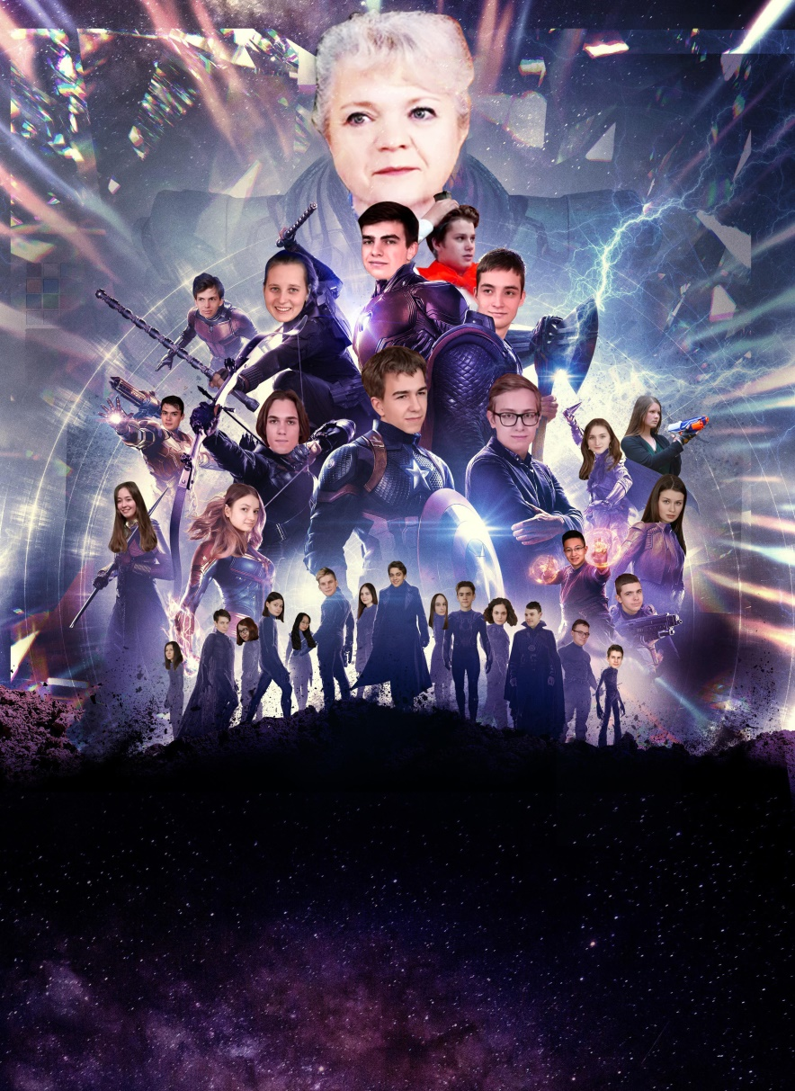
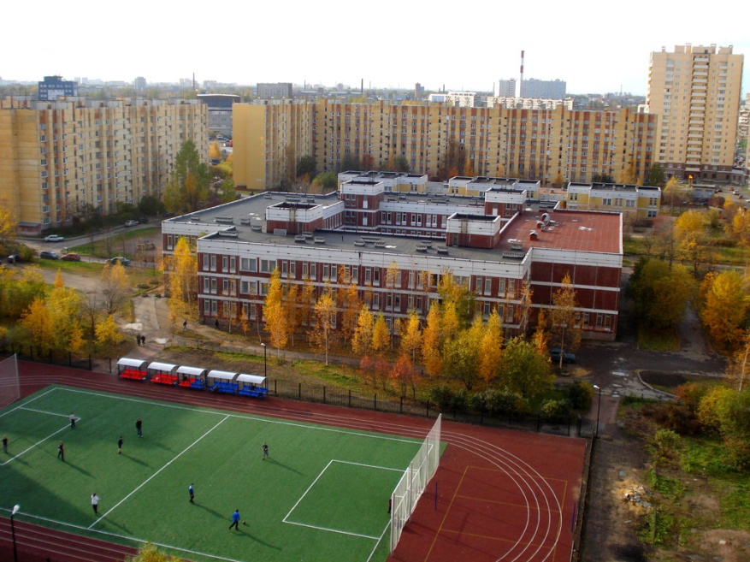
School

Slide 4
Old projects?

Slide 5
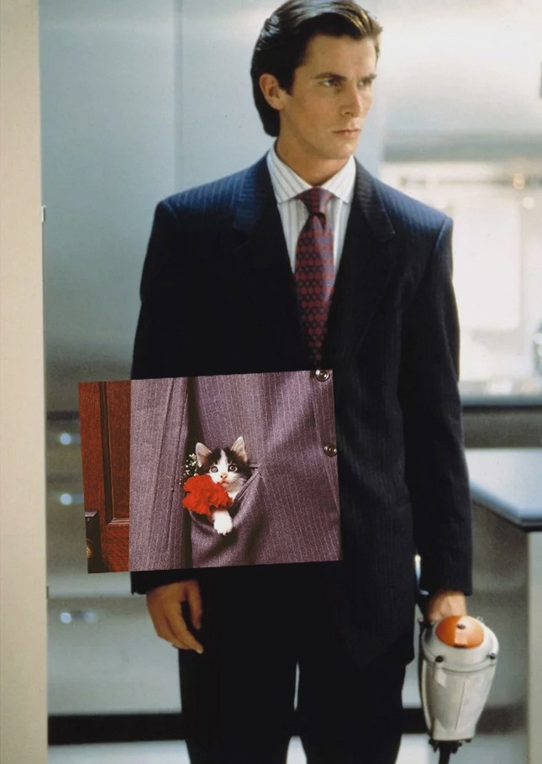
Thanks for listening!

